Slide 1


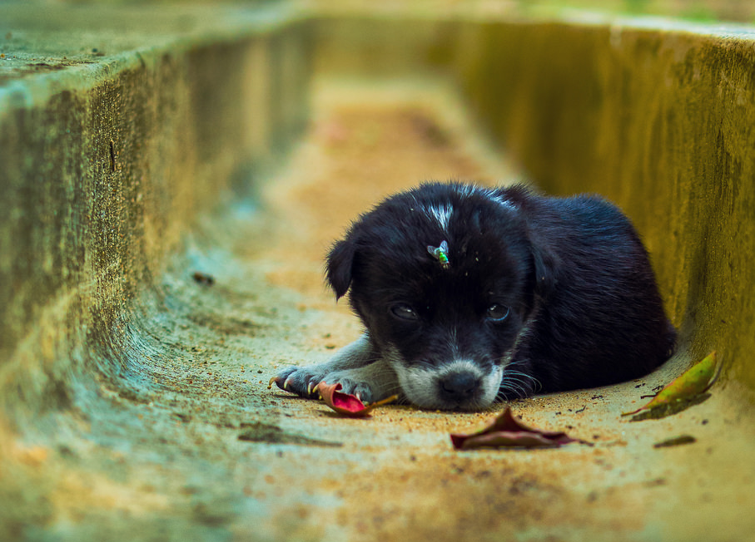
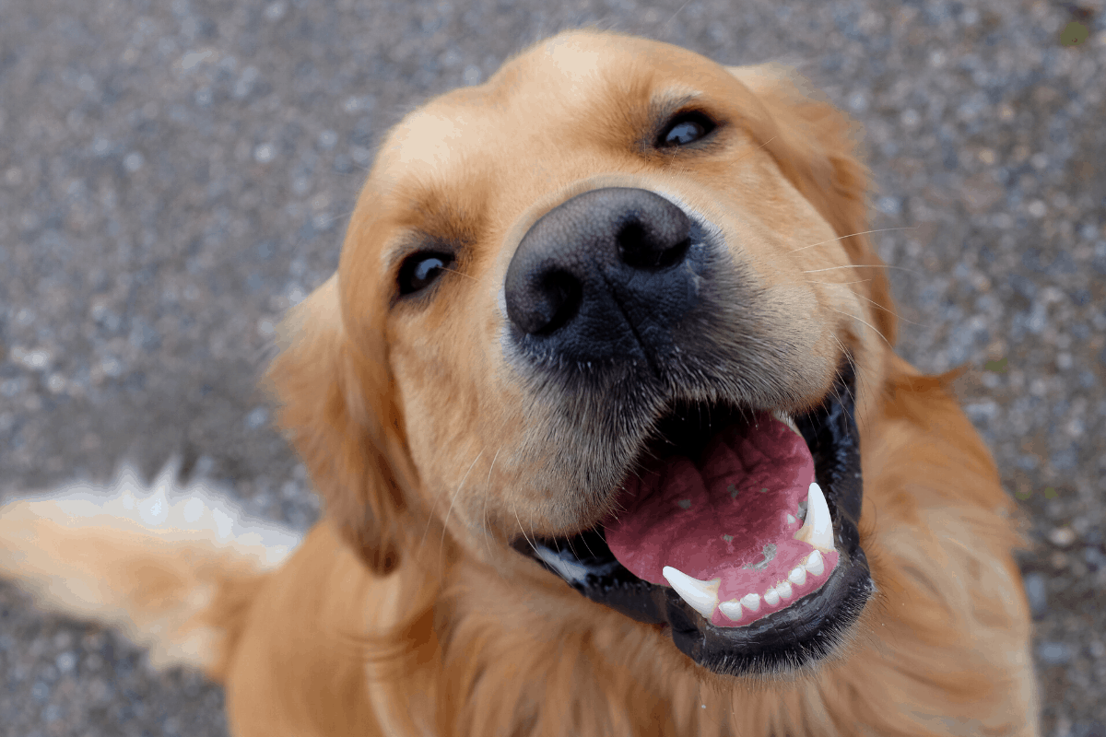
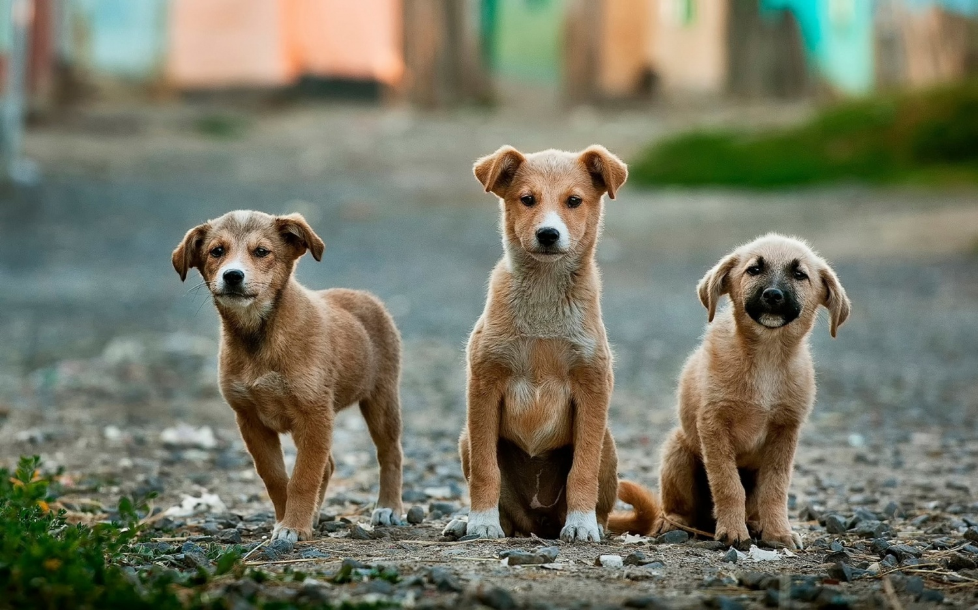
ADOPT!!! DON’T ABANDON…
ADOPT DON’T BUY

Slide 2


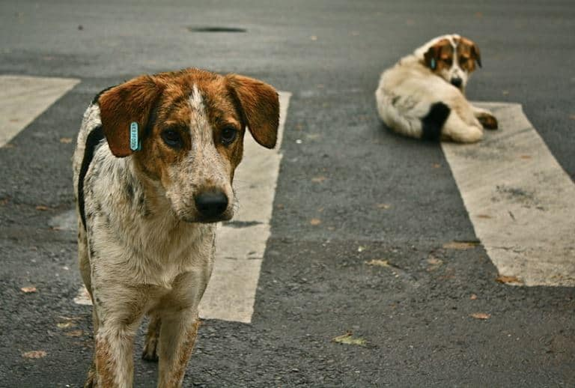
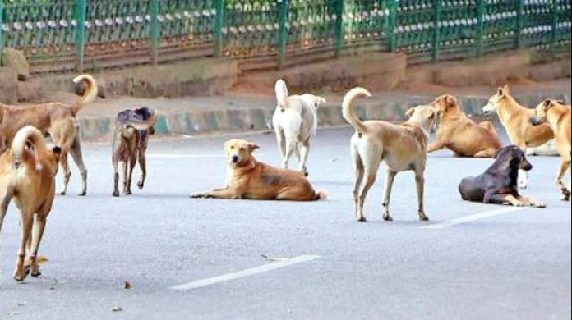
WHAT ARE STRAY ANIMALS ?...
Stray animals are defined as street animals that are born and reproduce on the street and have never been owned, lost animals that could not find their way home, or abandoned animals that are no longer wanted and are abandoned on the street or taken to a shelter by their owner.

Slide 3
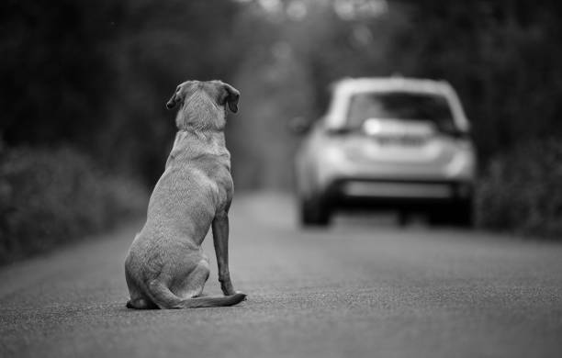


WHY ARE THEY STRAY ANIMALS?
IRRESPONSIBLE ANIMAL OWNER SHIP
UNCONTROLLED BREEDING
CARRYING CAPACITY
COLD SHOULDER

Slide 4
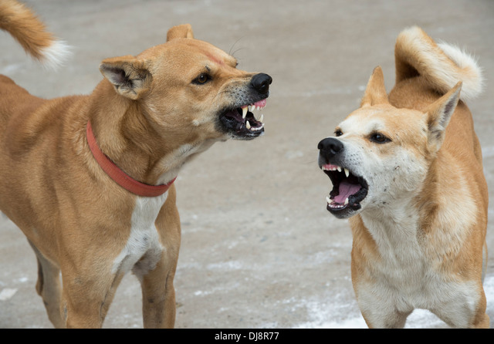
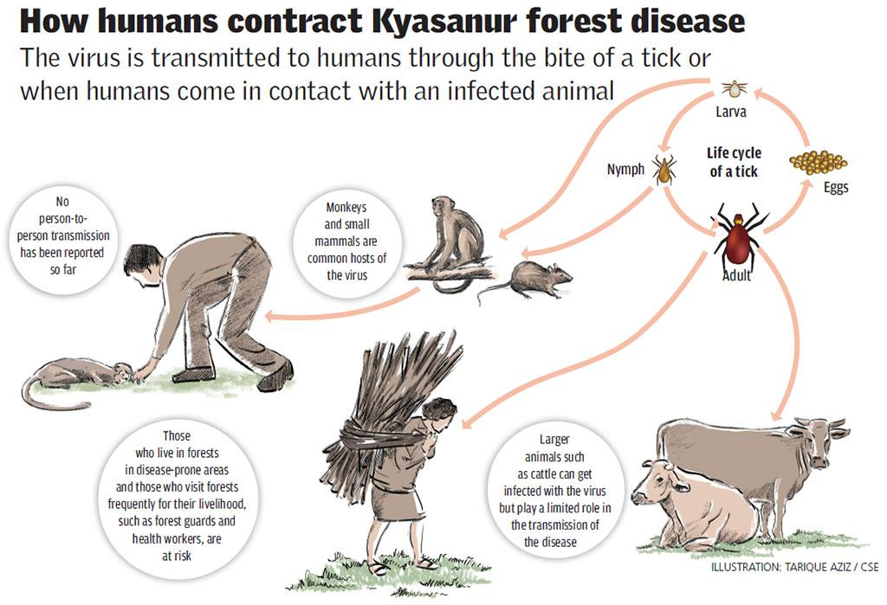
PROBLEMS CREATED BY THEM
CREATED NUISANCE(CREATES TROUBLE )
FATAL DISEASE WHICH CAN BE TRANSMITTED TO HUMANS
THEY MAY SCARE OF CHILDREN

Slide 5
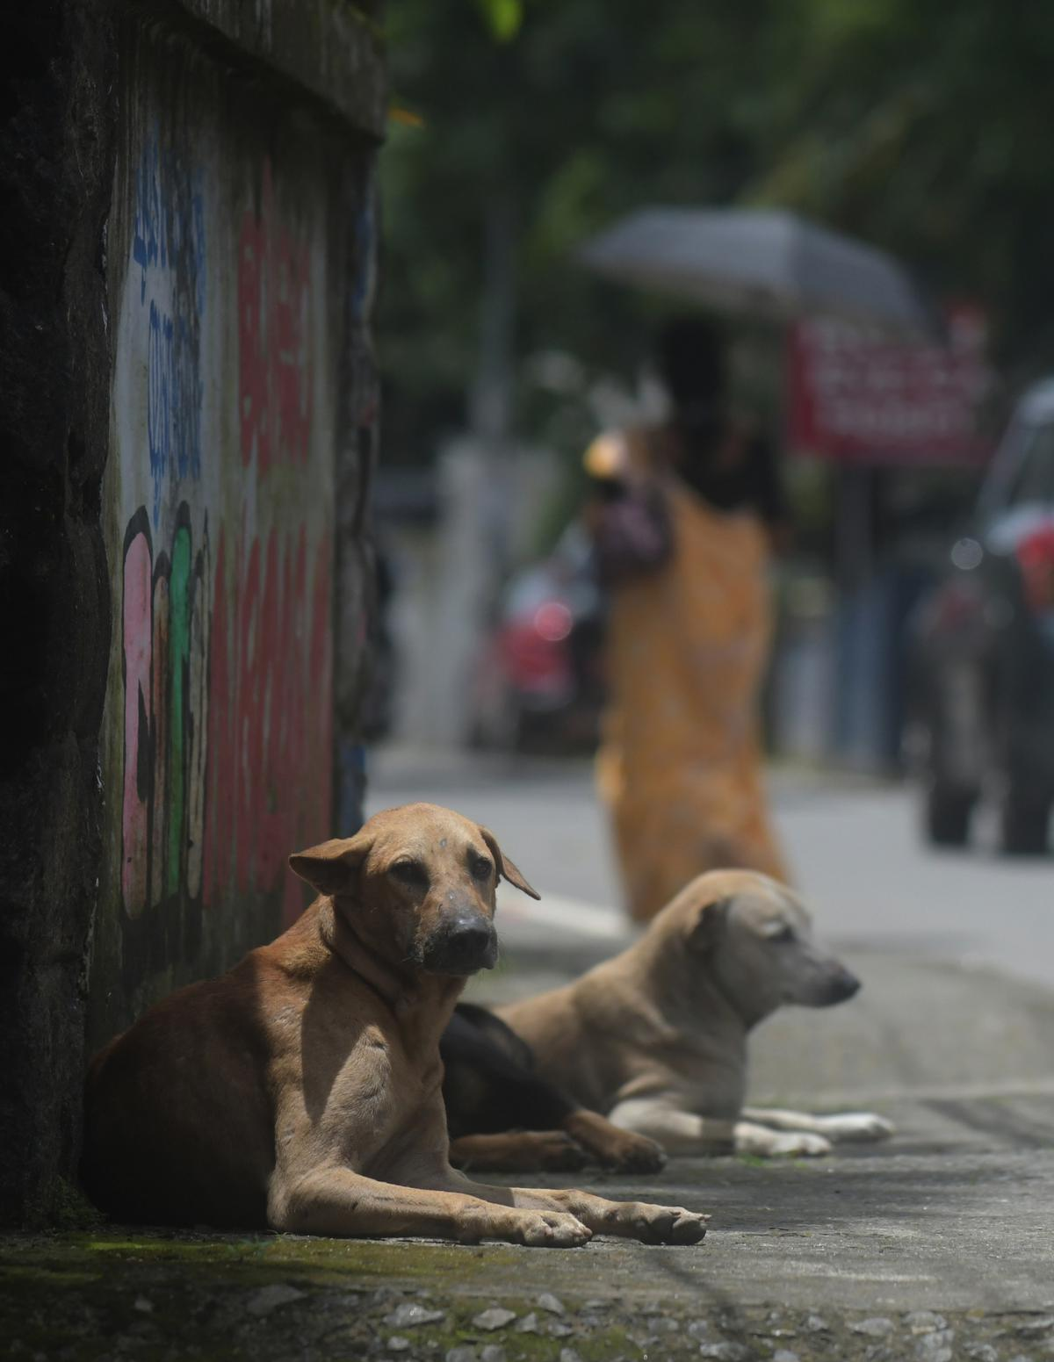
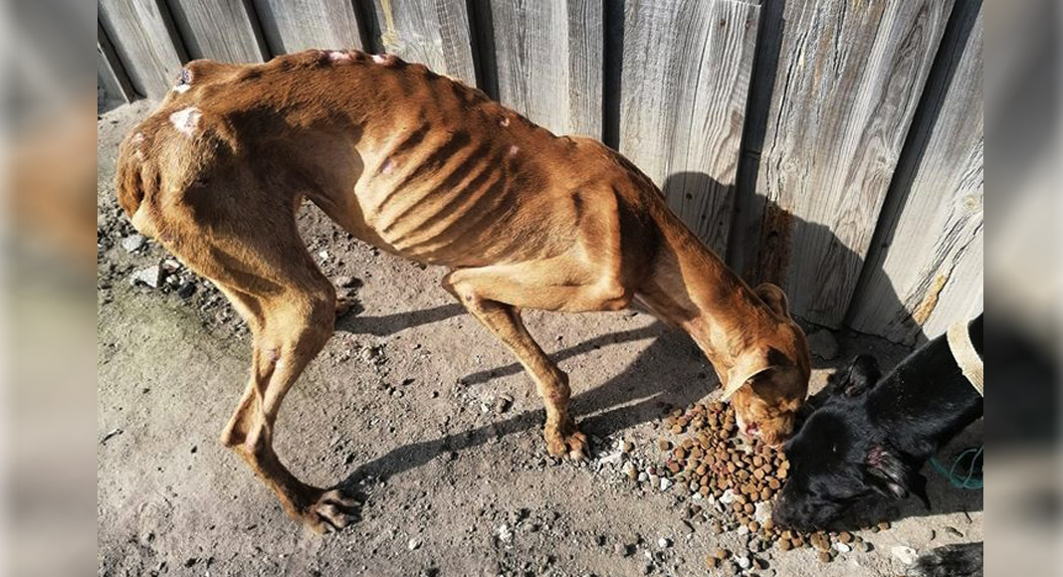
PROBLEMS CREATED FOR THEM
HUNGER ILLNESS
FOOD SHELTER
HEALTH HAZARDS
ROAD ACCIDENTS

Slide 6
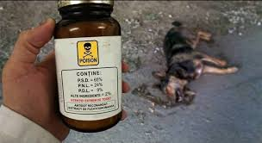
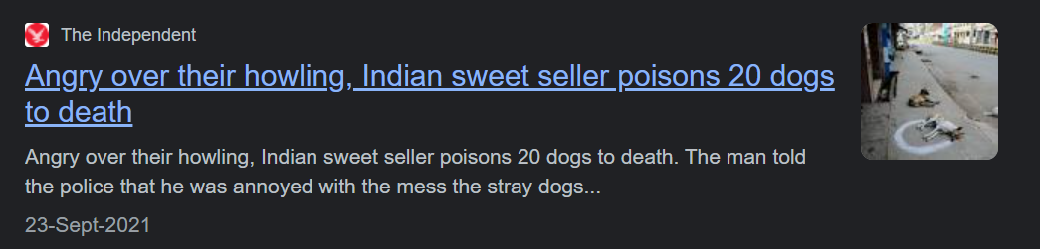
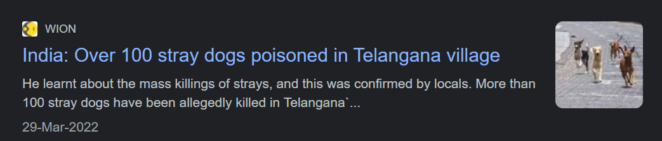
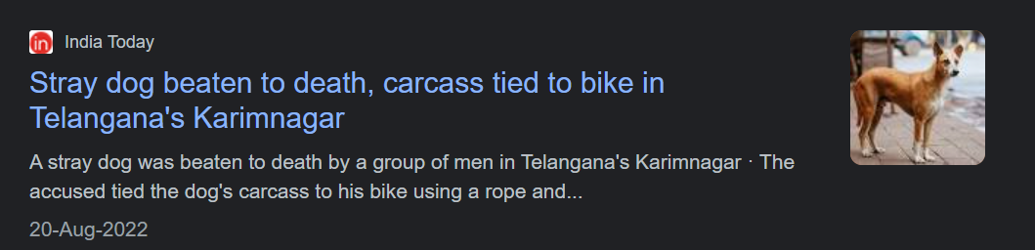
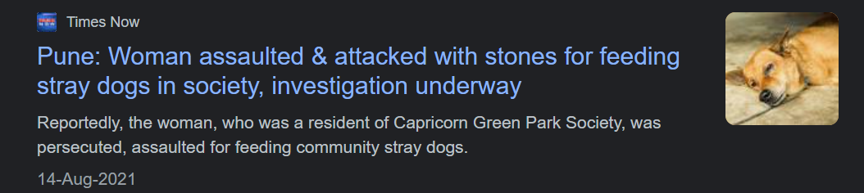
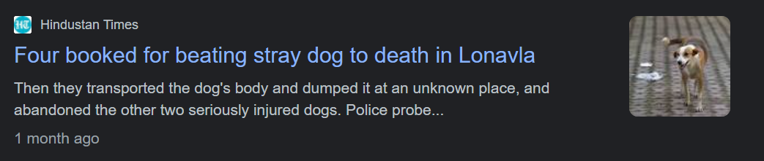
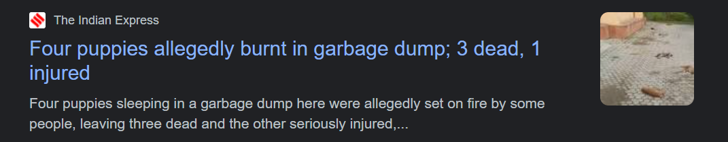
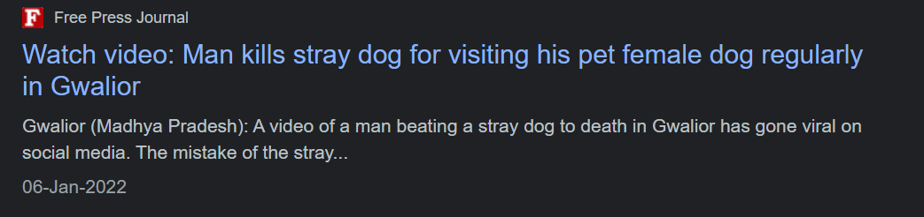
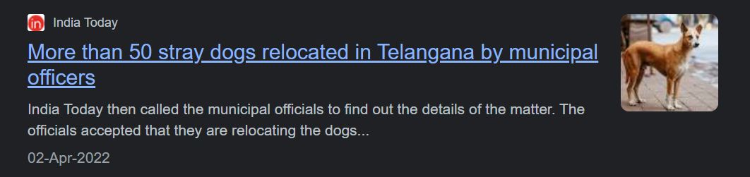
NEWS RELATED TO HARASSMENNT OF STRAY DOGS!

Slide 7



CONTROL STRATERGIES
ADDRESSING THE SOURCE OF STRAY ANIMALS
NEUTERING/STERILIZATION OF OWNED ANIMALS AND STRAY ANIMALS
REDUCING CARRYING CAPACITY
CATCH NEUTER AND RELEASE (CNR) PROGRAMMERS
INTRODUCING NGO’S FOR SHELTER AND CARE EG: SAHAS PUNE

Slide 8

ABOUT SAHAS PUNE
Saahas For Animals Foundation is a Private incorporated on 19 December 2019. It is classified as Non-govt company and is registered at Registrar of Companies, Pune. Its authorized share capital is Rs. 100,000 and its paid up capital is Rs. 100,000. It is inolved in Social work activities Saahas For Animals Foundation's Annual General Meeting (AGM) was last held on N/A and as per records from Ministry of Corporate Affairs (MCA), its balance sheet was last filed on N/A. Directors of Saahas For Animals Foundation are Gitanjali Prakash Tour, Omkar Dilip Jagdale, Ravi Vijayakumar Gupta and Yogeshwar Asaram Shelar. Saahas For Animals Foundation's Corporate Identification Number is (CIN) U85310PN2019NPL188502 and its registration number is 188502.Its Email address is omkardj111@gmail.com and its registered address is BLDG A - 1201 S.NO 142/1/2B, AISHWARYAM VENTURES, HAVELI, PIMPRI CHINCHWAD PUNE Pune MH 411019 IN , - , . Current status of Saahas For Animals Foundation is - Active.

Slide 9

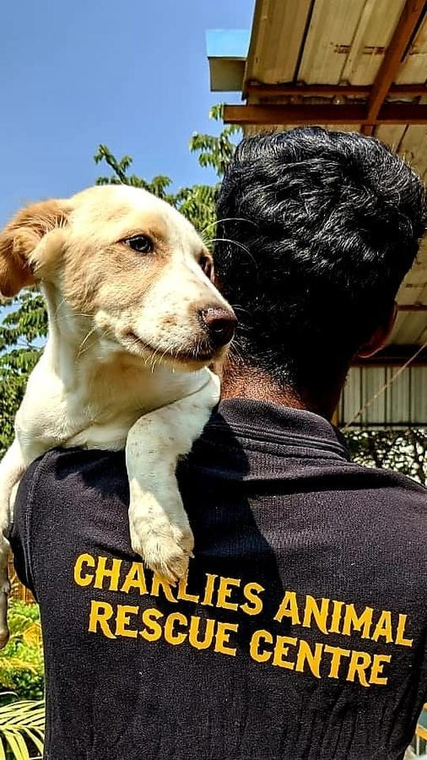
ADOPT THEM IF NOT, FEED THEM IF NOT, DONATE FOR THEM IF NOT, THEN ATLEAST DON’T ABUSE/INJURE

